Slide 1
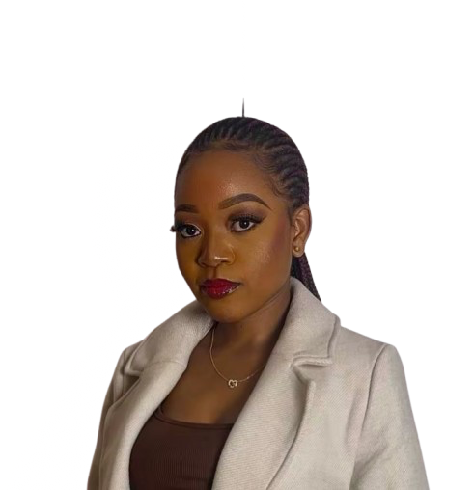
Hello, I am
Memory T. Muzira
Future Fintech Pro
View My Portfolio

Slide 2
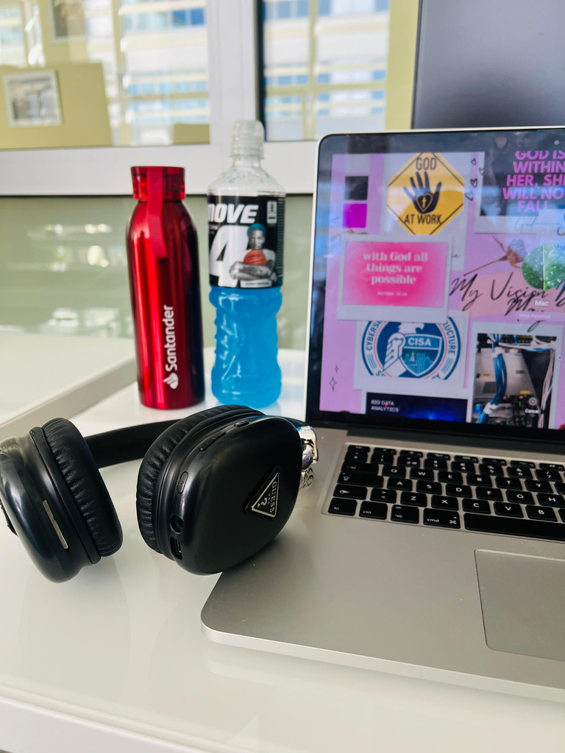

Who I Am and What I Do
I’m Memory Muzira, a passionate student exploring the intersection of accounting, business, and computer science. My focus is on fintech
developing smart, secure, and efficient solutions for real-world financial challenges. I work on projects involving cybersecurity, UX design, and web development, while also building skills in financial modeling, risk assessment, and fraud prevention. I enjoy blending creativity with logic to bring ideas to life and contribute to safer, more innovative financial systems.

Slide 3

I am fortunate
to have worked with these companies
ROODFAN
MIKRI POLI
Netrix
HOTEL

Slide 4
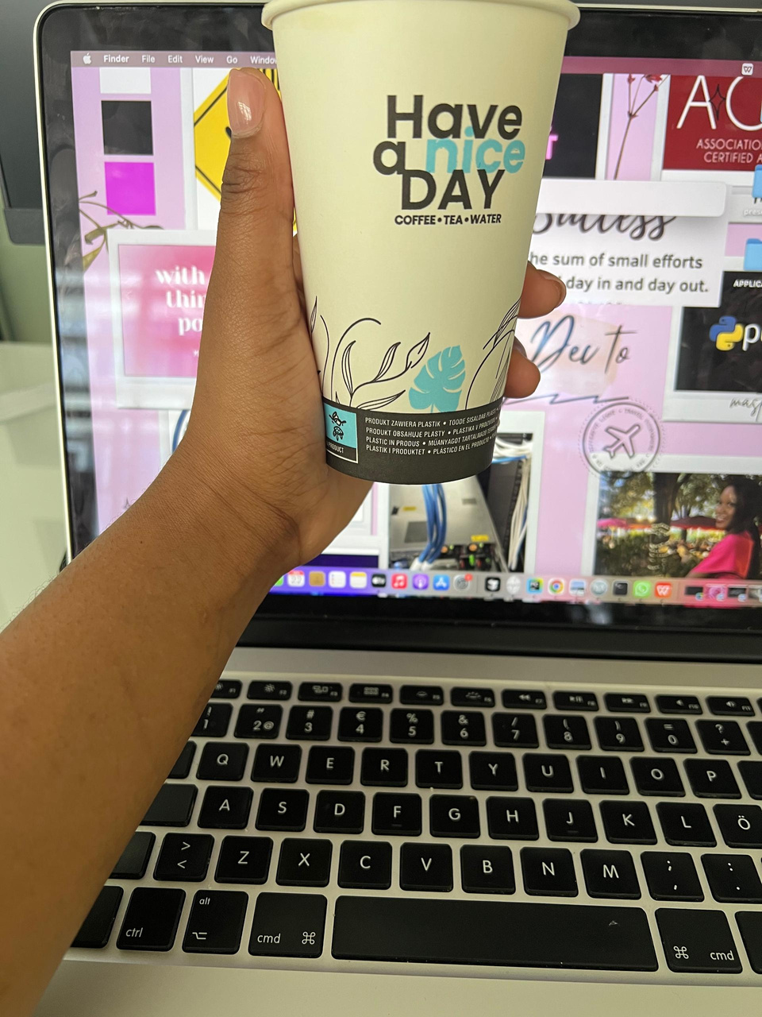
What My Clients Say
Working with Memory was a seamless experience. Her attention to detail and ability to combine technical skills with business insight really set her apart.
- Ropafadzo | Founder and CEO, Roodfan

Slide 5

Get in Touch
Email
Phone
Address
muziramemory02@gmail.com
123-456-7890
Zelazna 72, Lublin

